Slide 1
KYTC District 6 “Great Eight” Incident Management Task Force
April 16, 2013

Slide 2
Introductions

Slide 3
Approval of Minutes
1/8/13 Meeting

Slide 4
Incident Review
How to Manage a Small Highway Spill
Kevin Strohmeier - Dept. for Environmental Protection

Slide 6
Incident Review
I-75 NB Tractor Trailer Crash with Fuel Spill
Grant County MP 161
When do Recovery Services Need an Encroachment Permit?

Slide 8
Incident Review
I-71 SB Cream Tanker Truck Crash
Carroll Co.@ MP 50

Slide 9
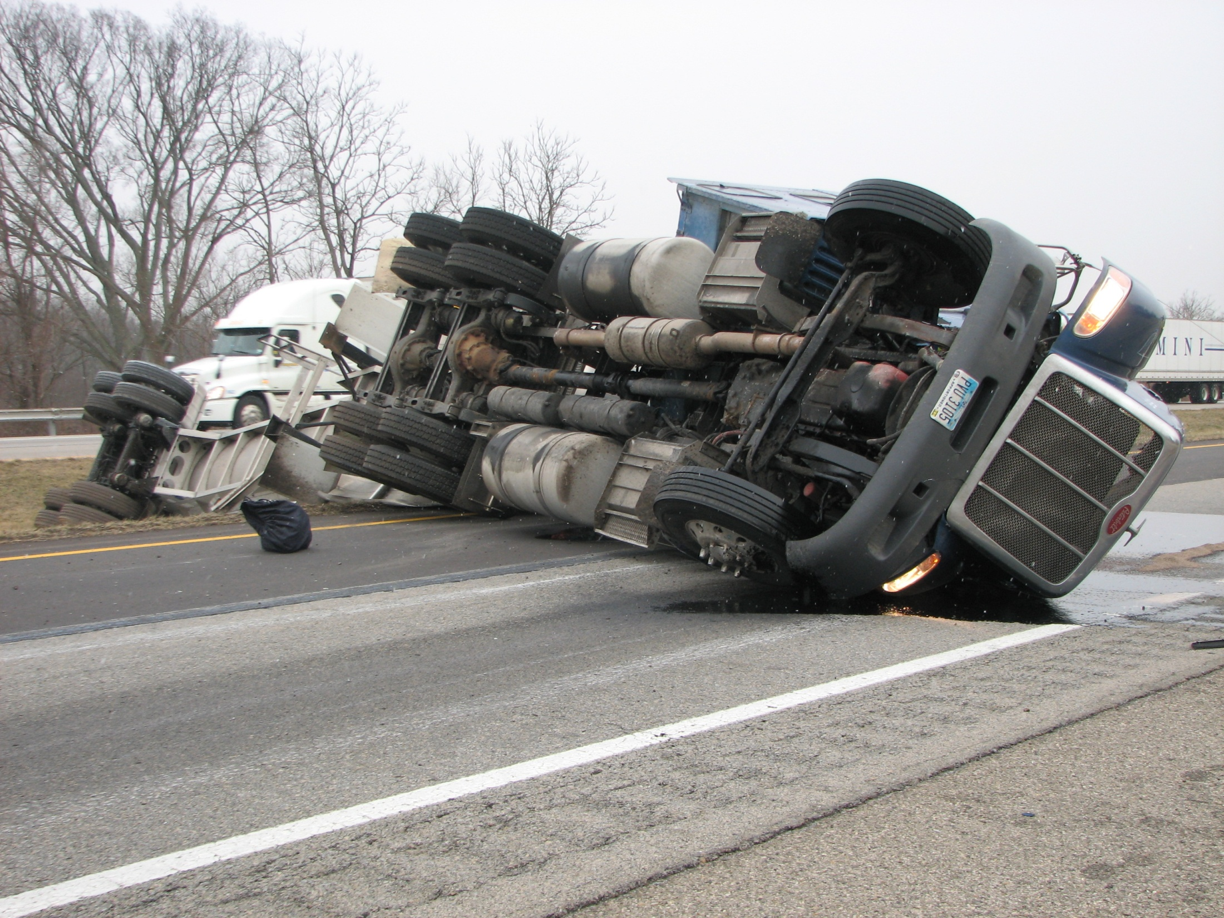

Slide 10
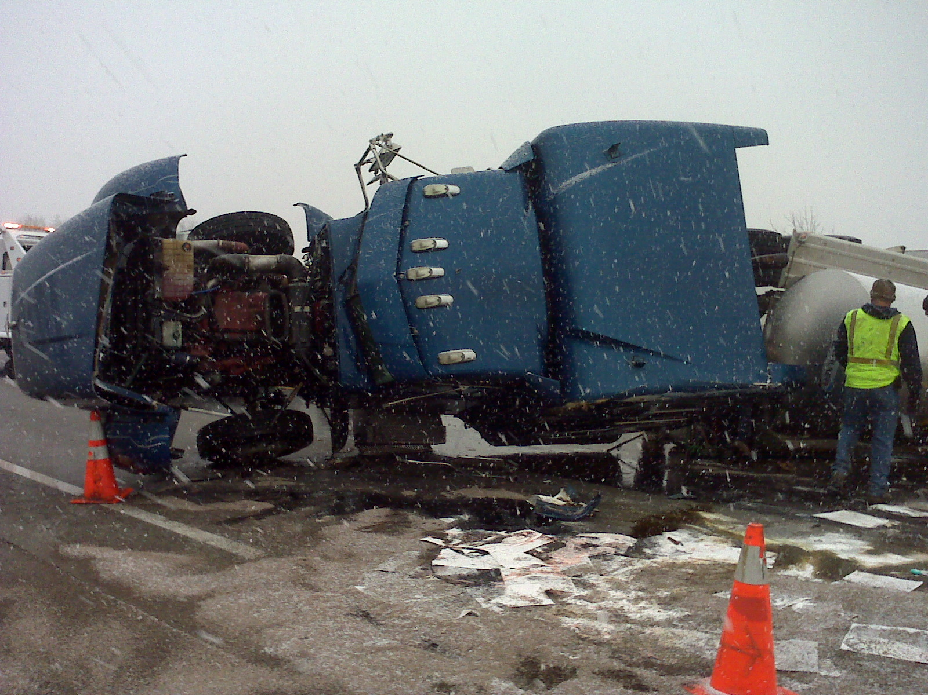

Slide 11
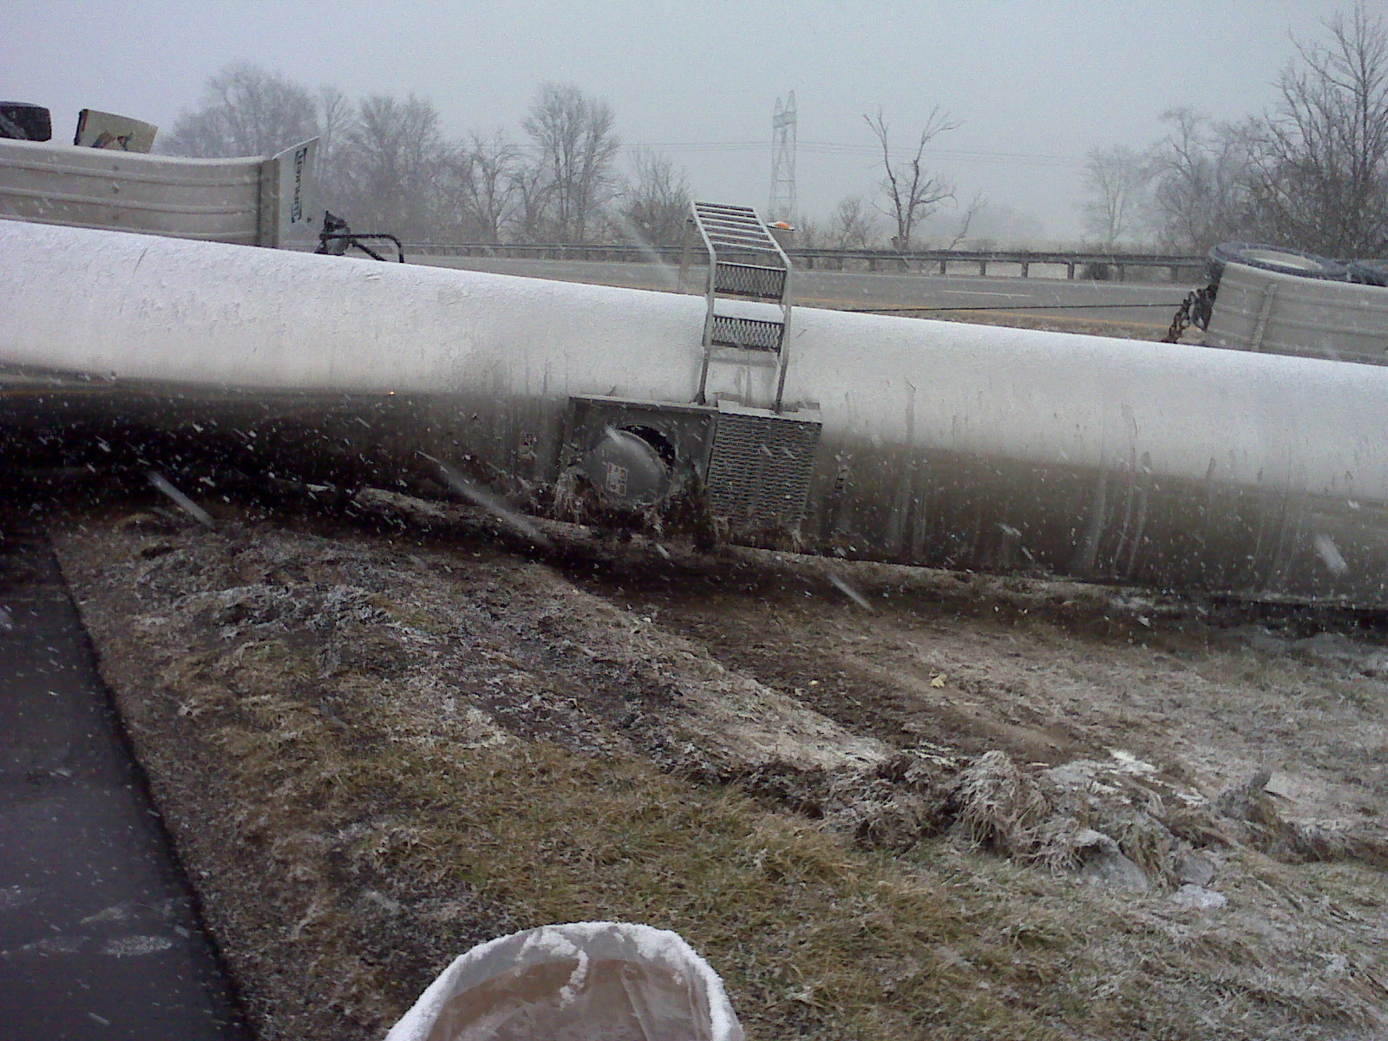

Slide 12
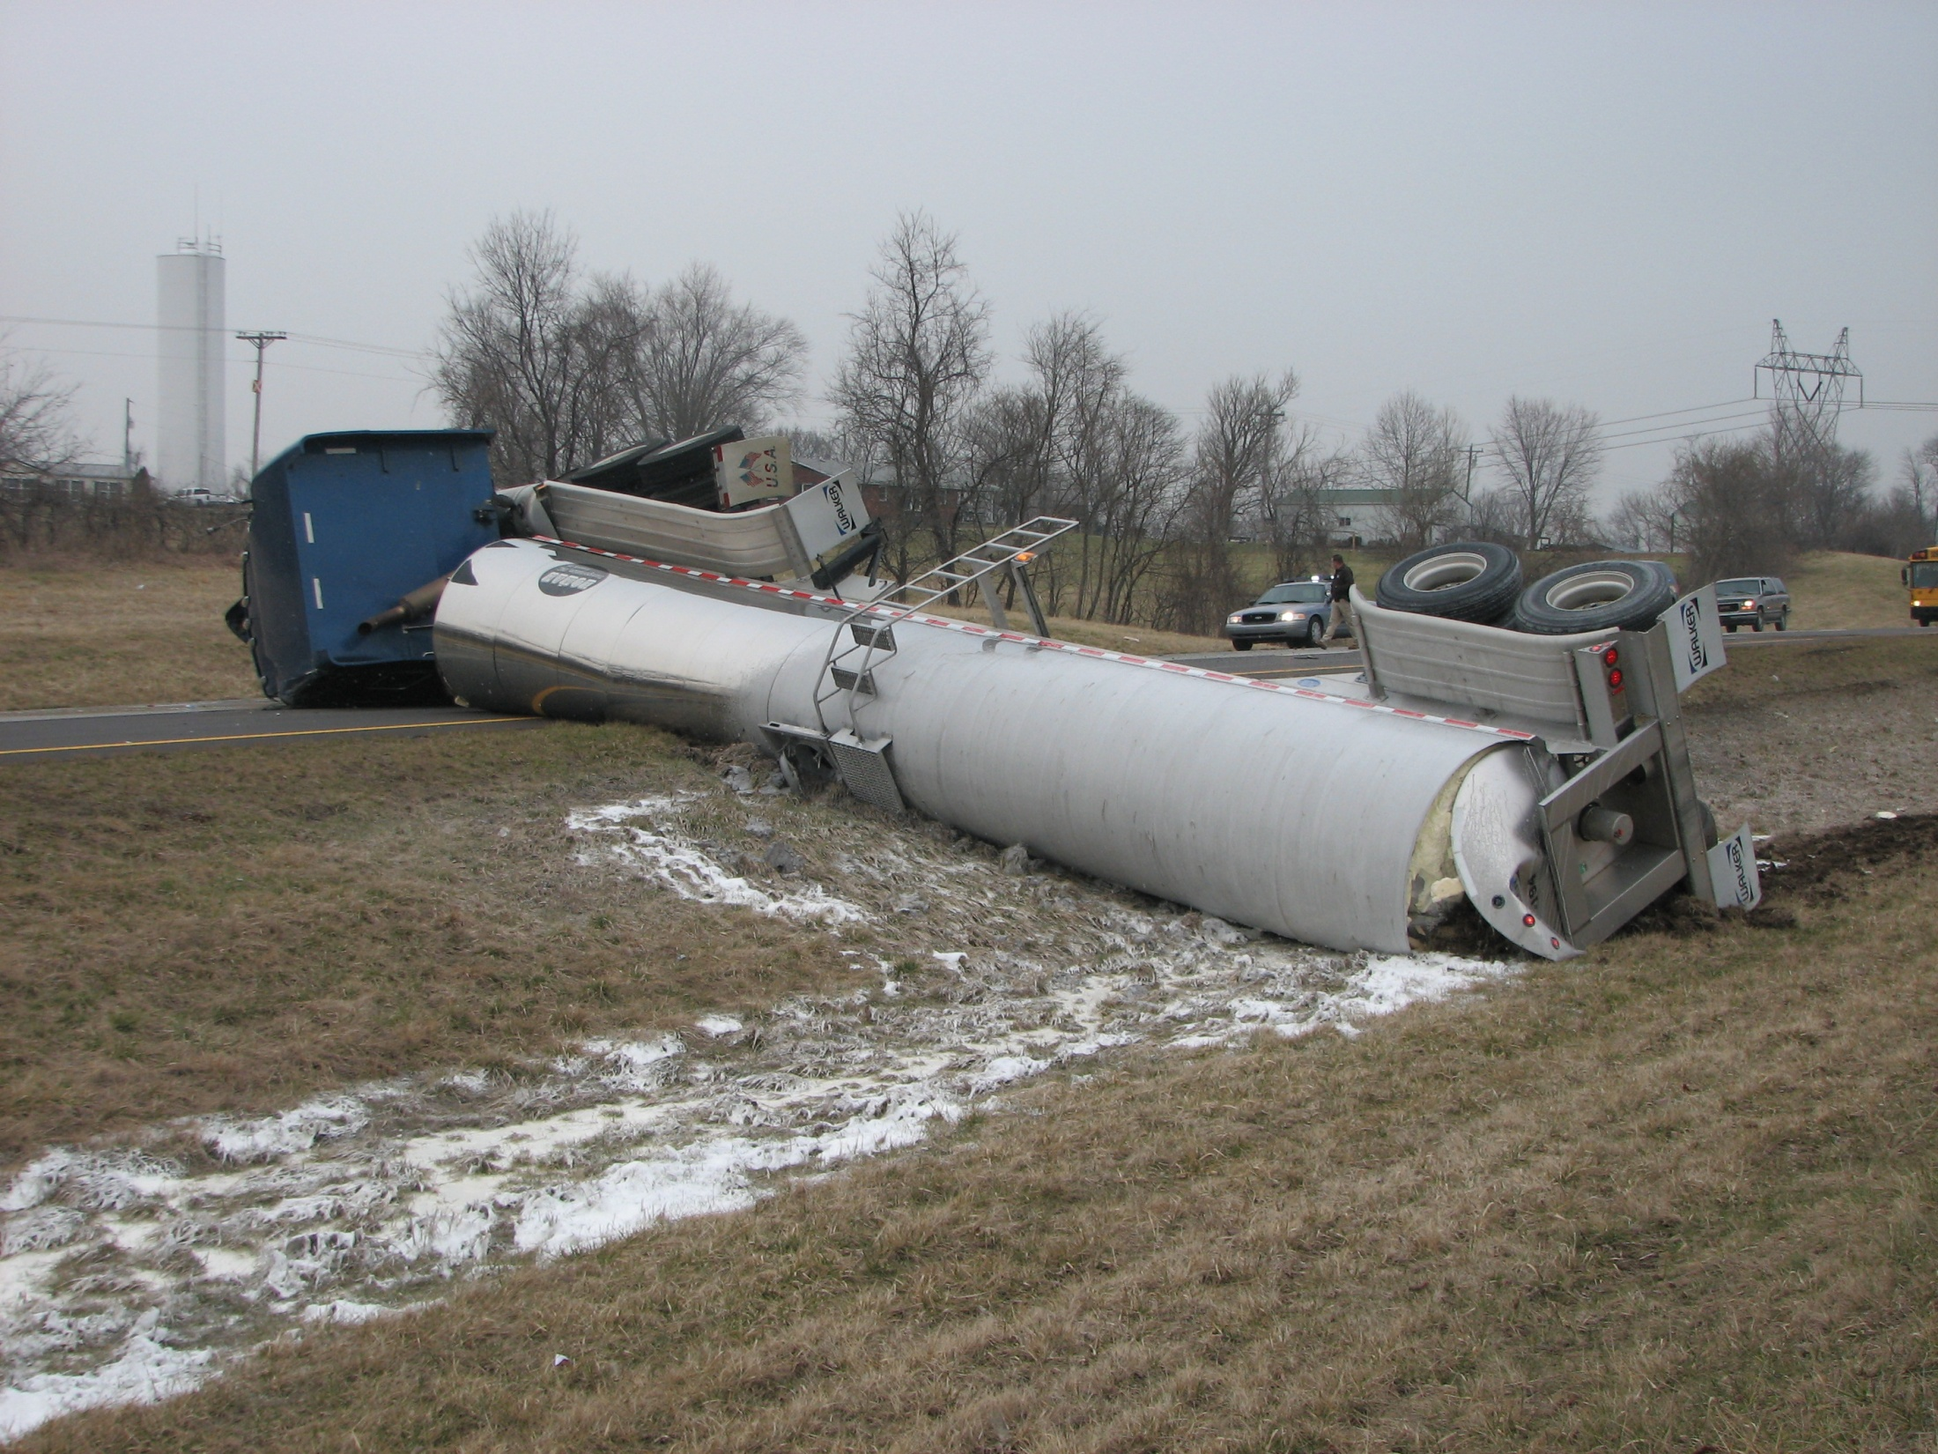

Slide 13
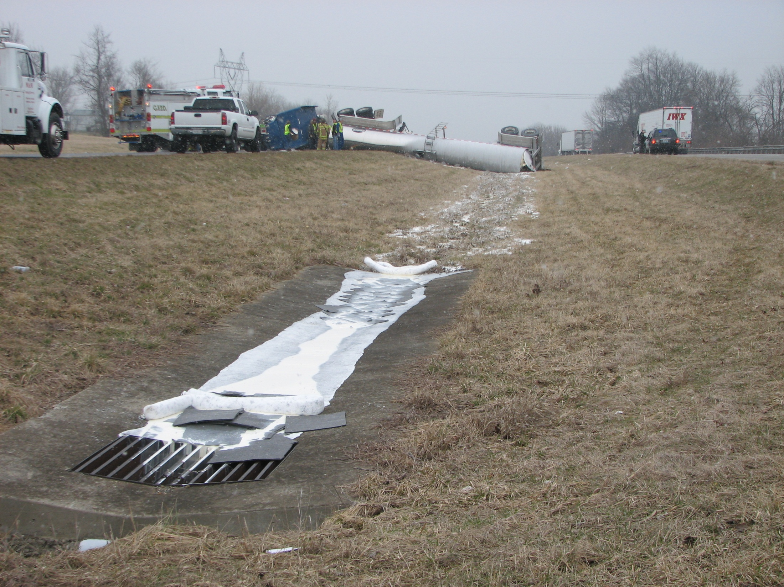

Slide 14
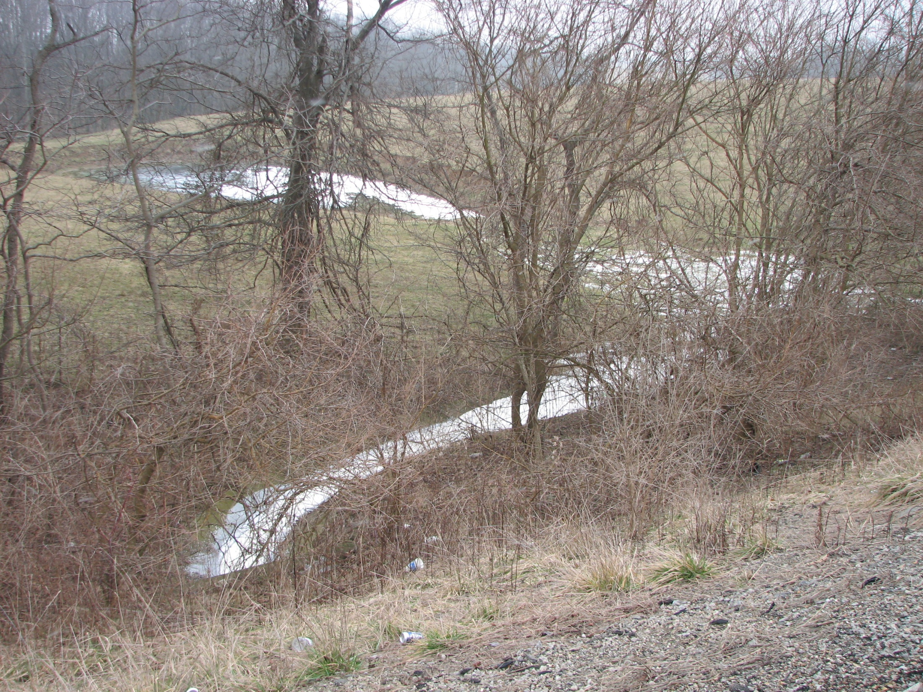

Slide 15
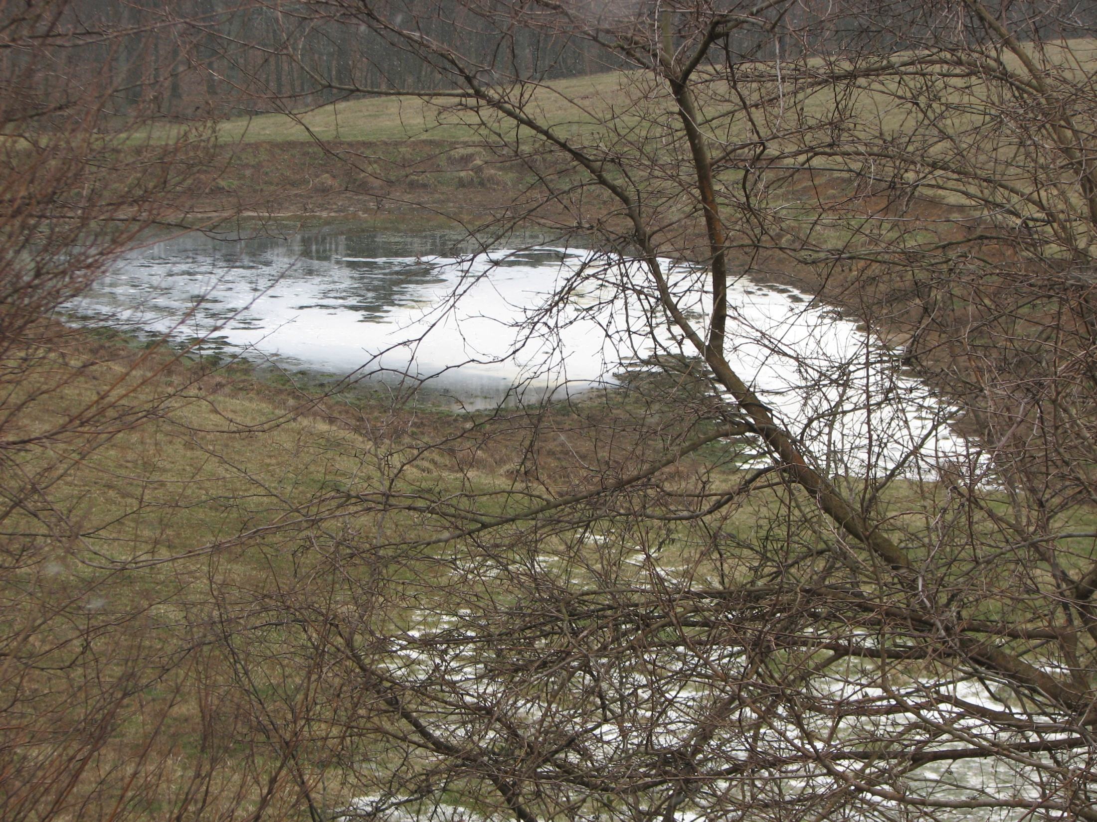

Slide 16
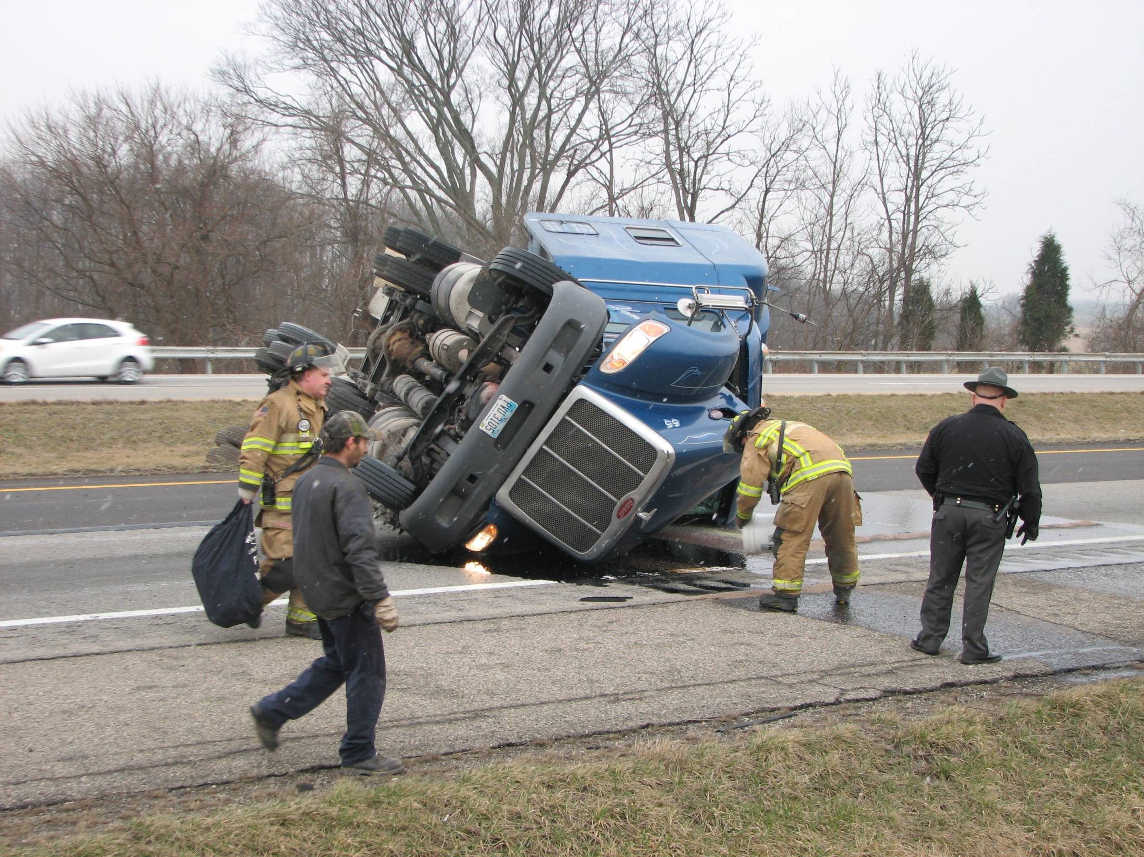

Slide 17
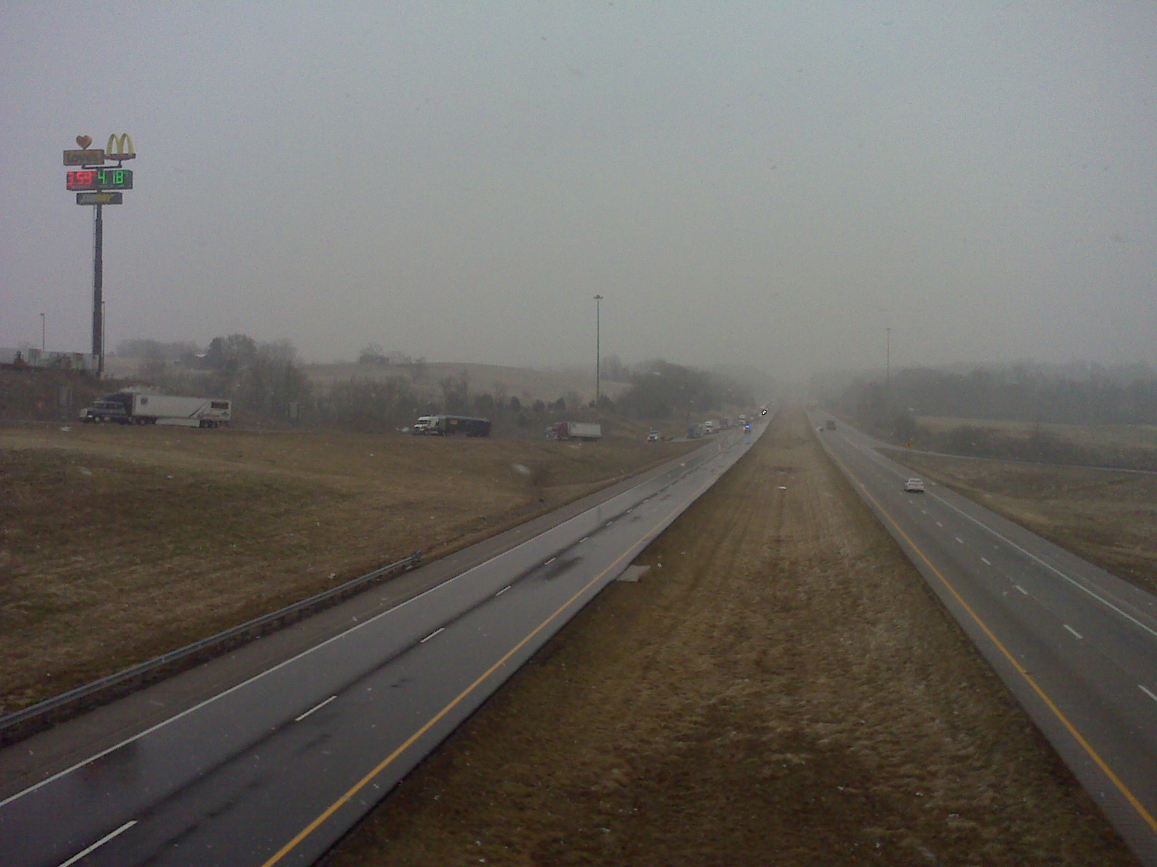

Slide 18
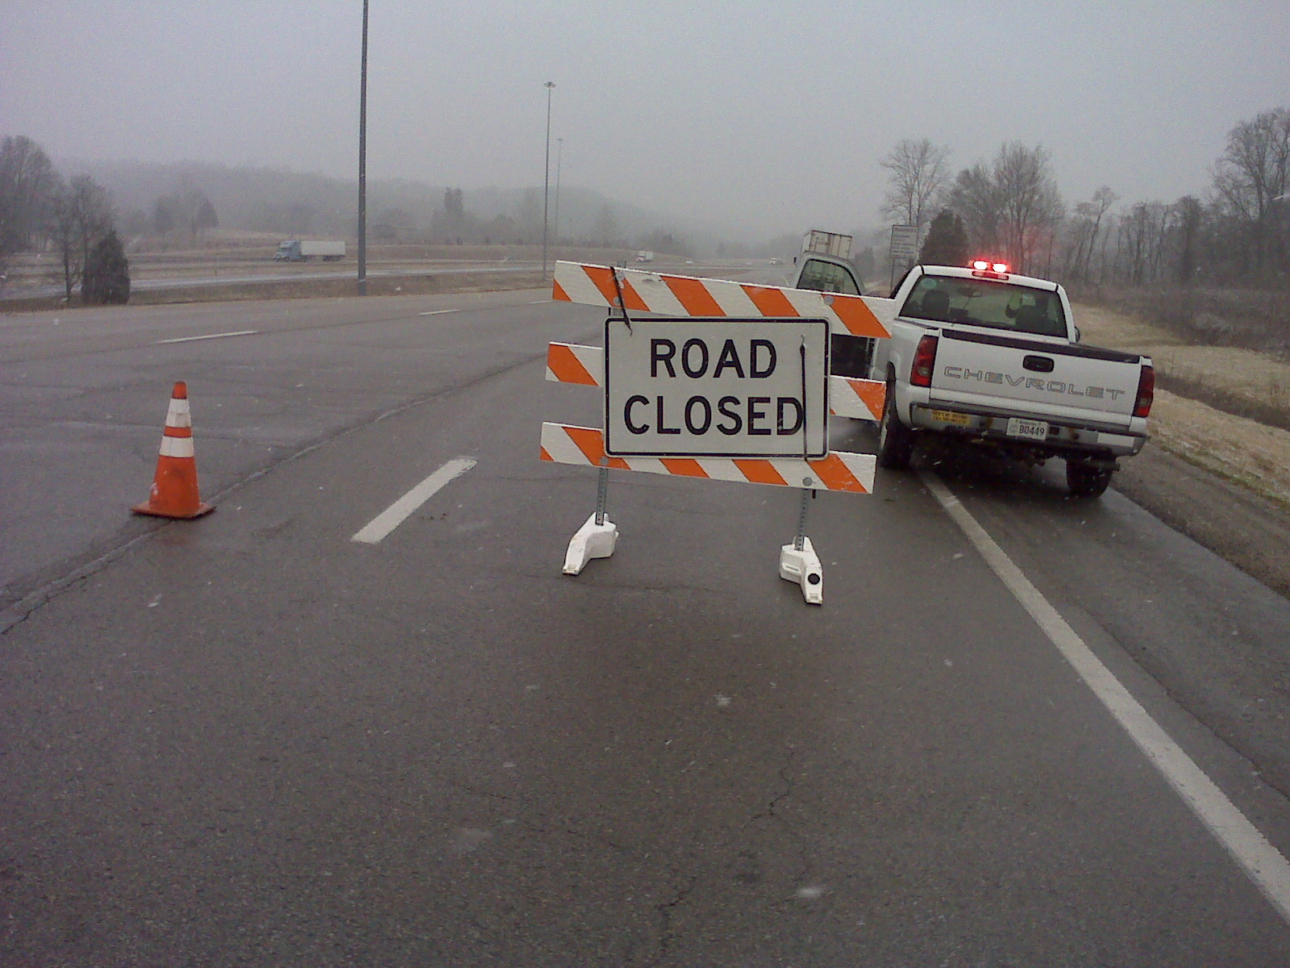

Slide 19
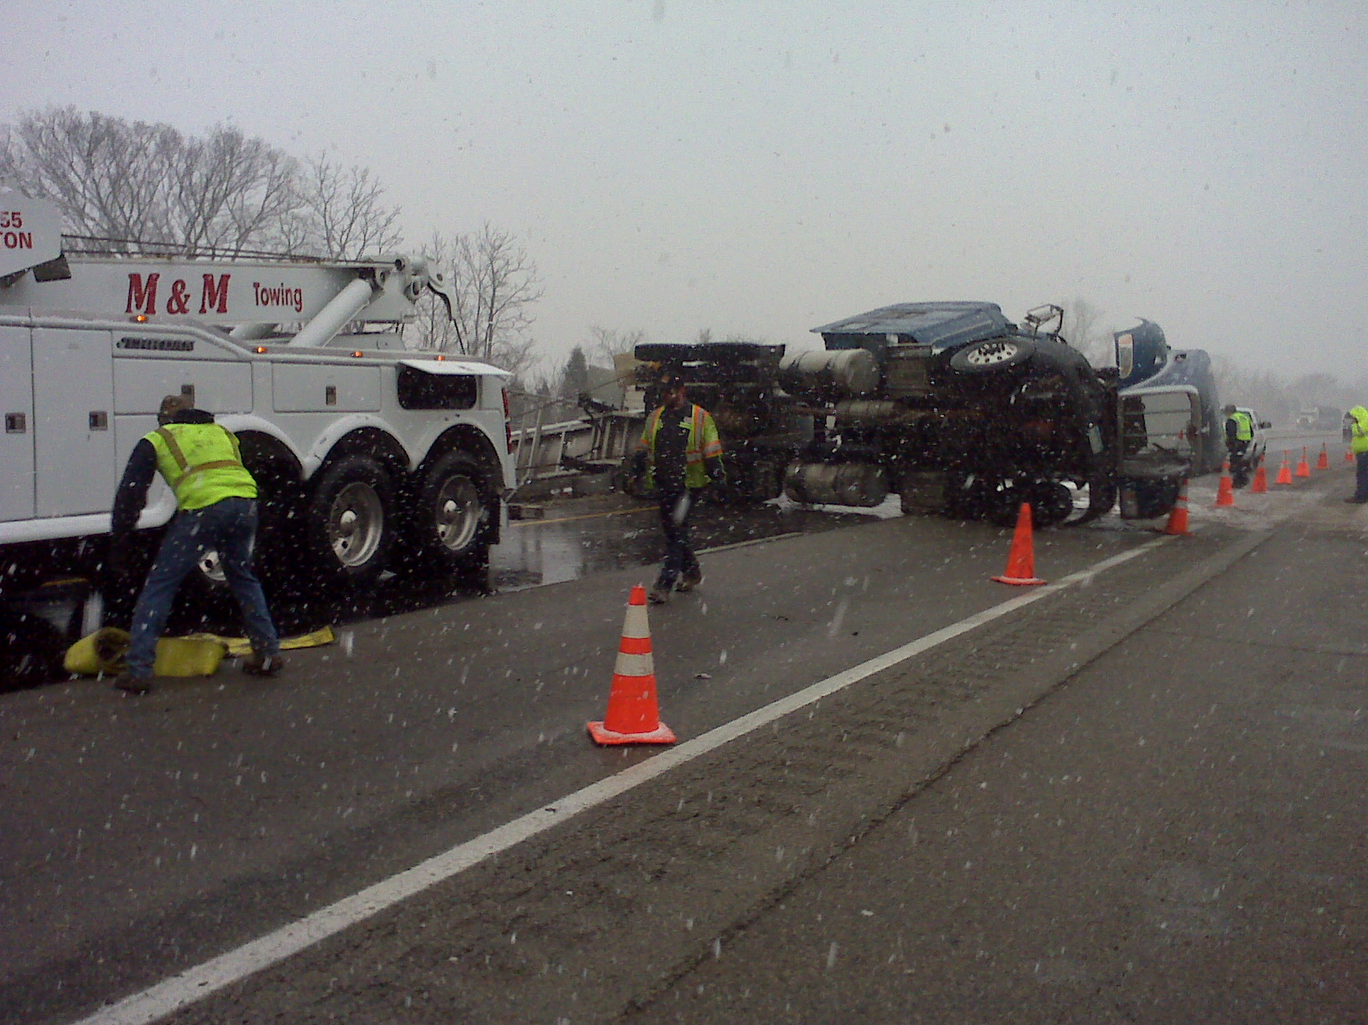

Slide 20
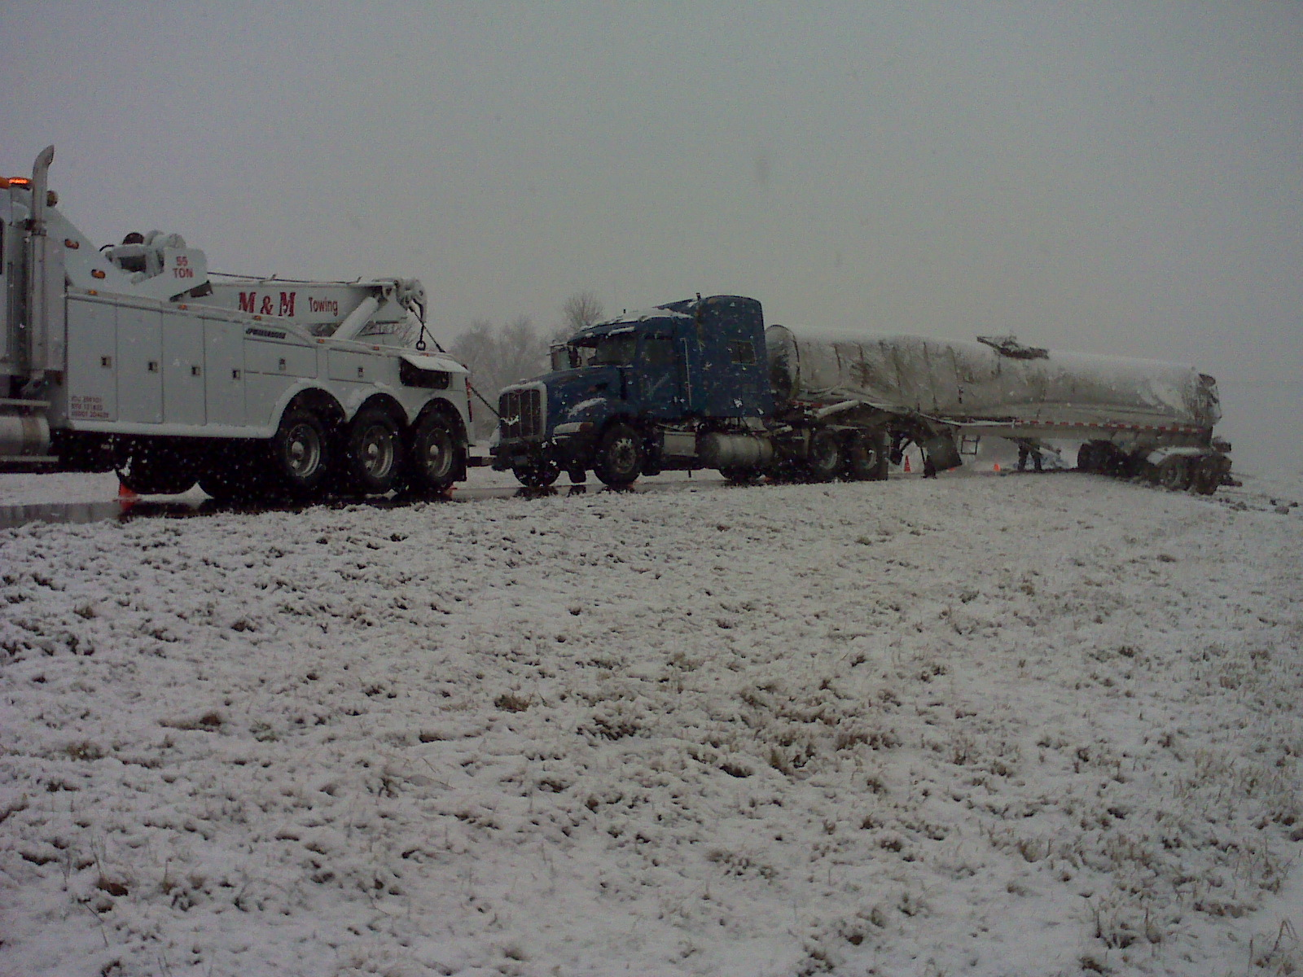

Slide 21
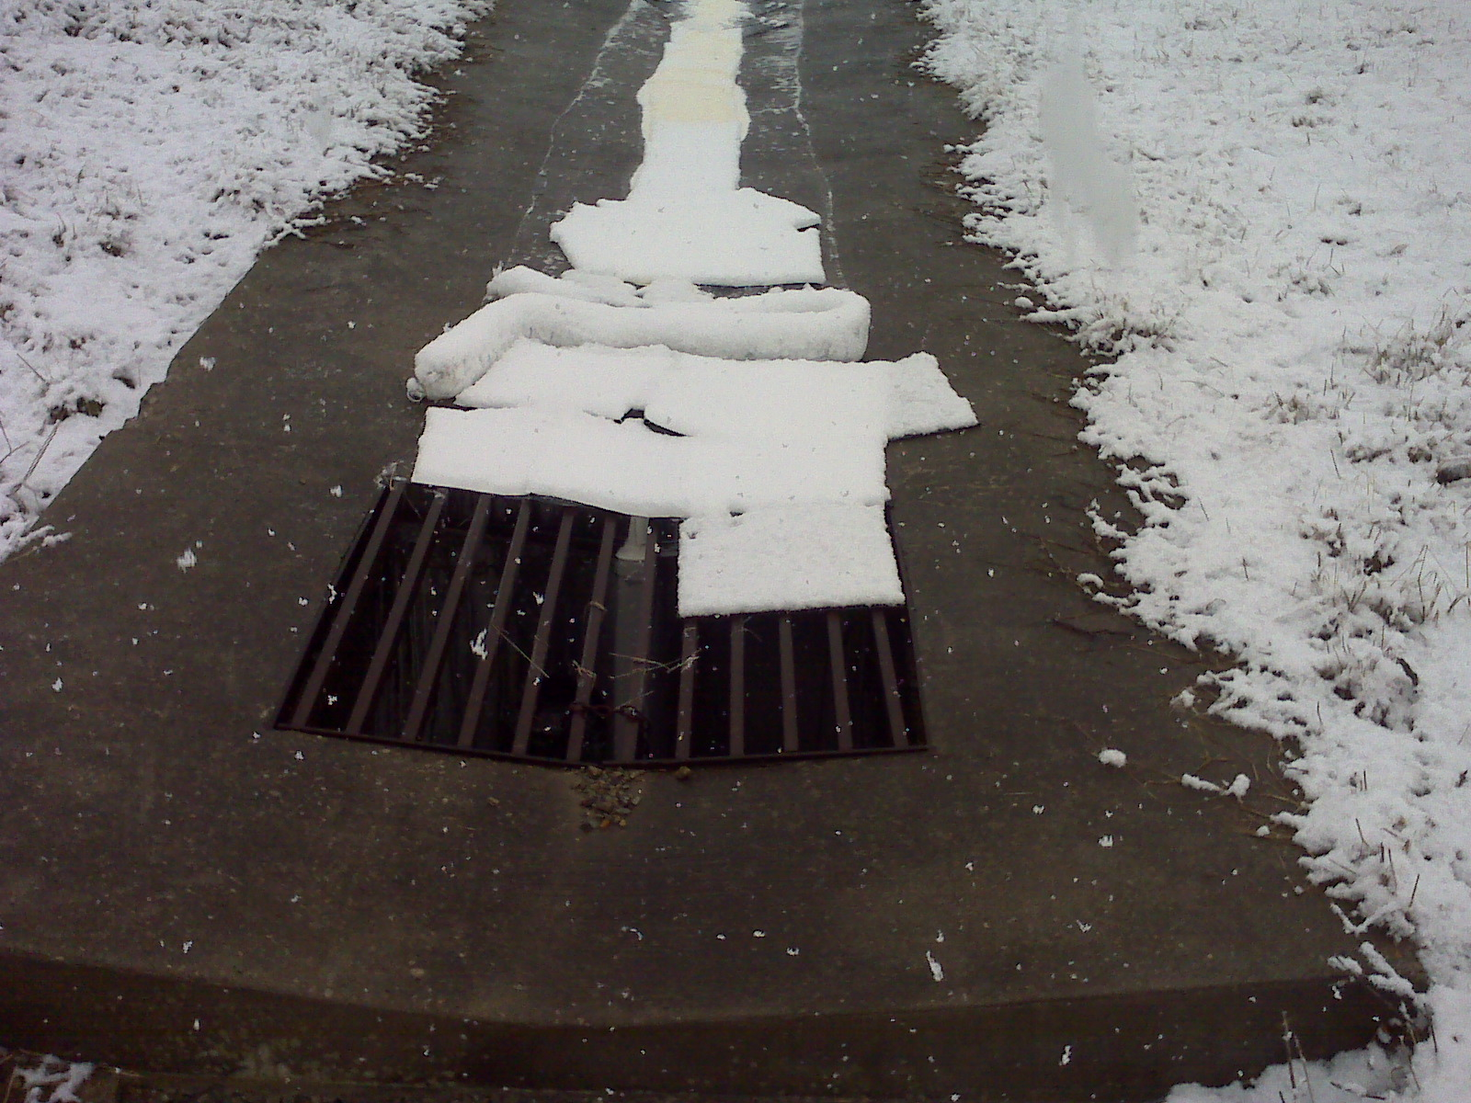

Slide 22
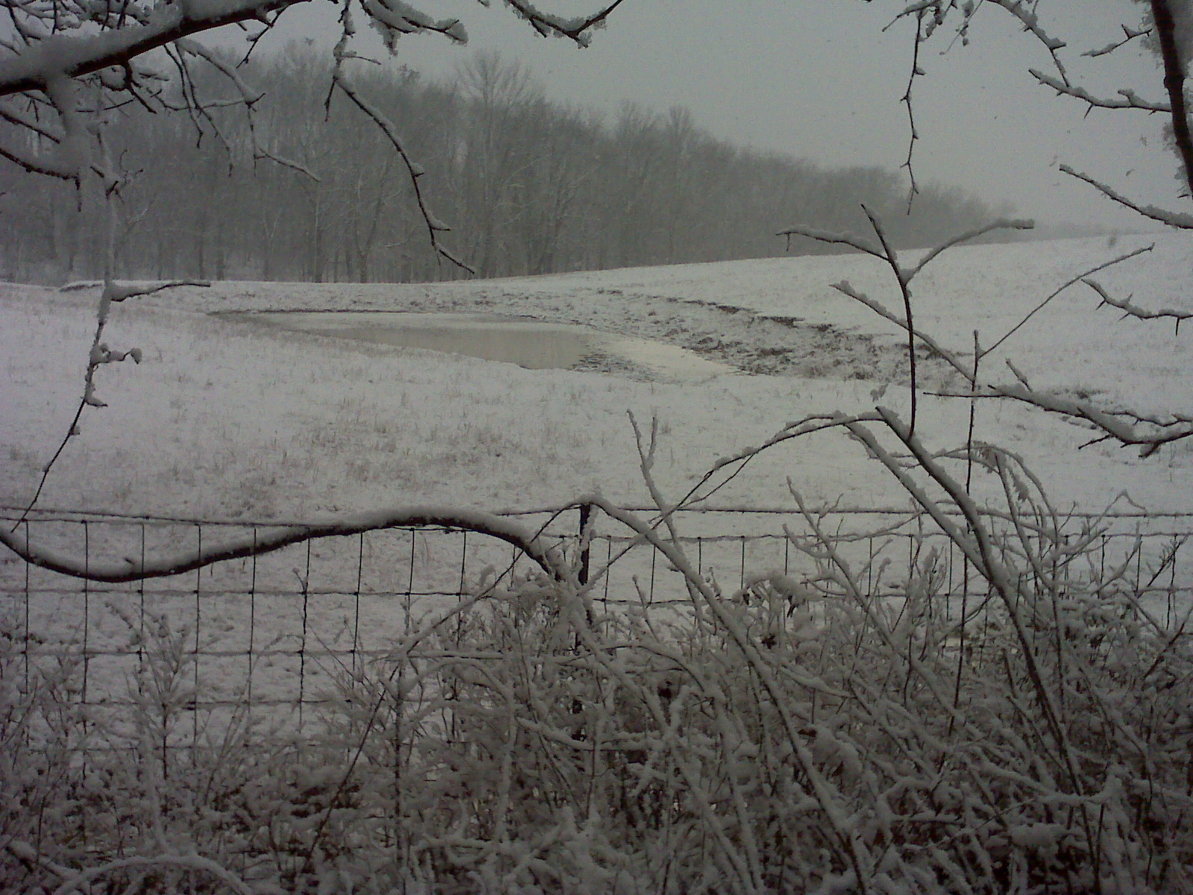

Slide 23
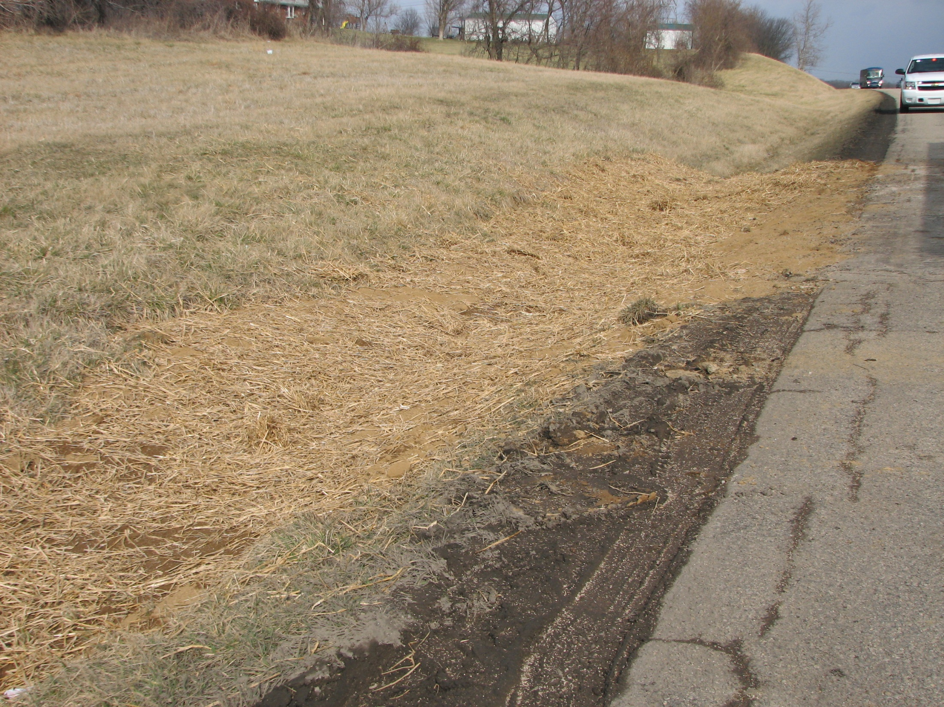

Slide 24
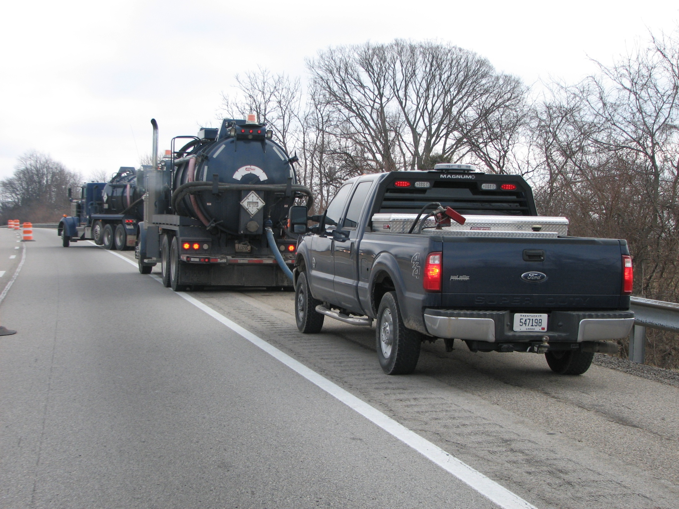

Slide 25
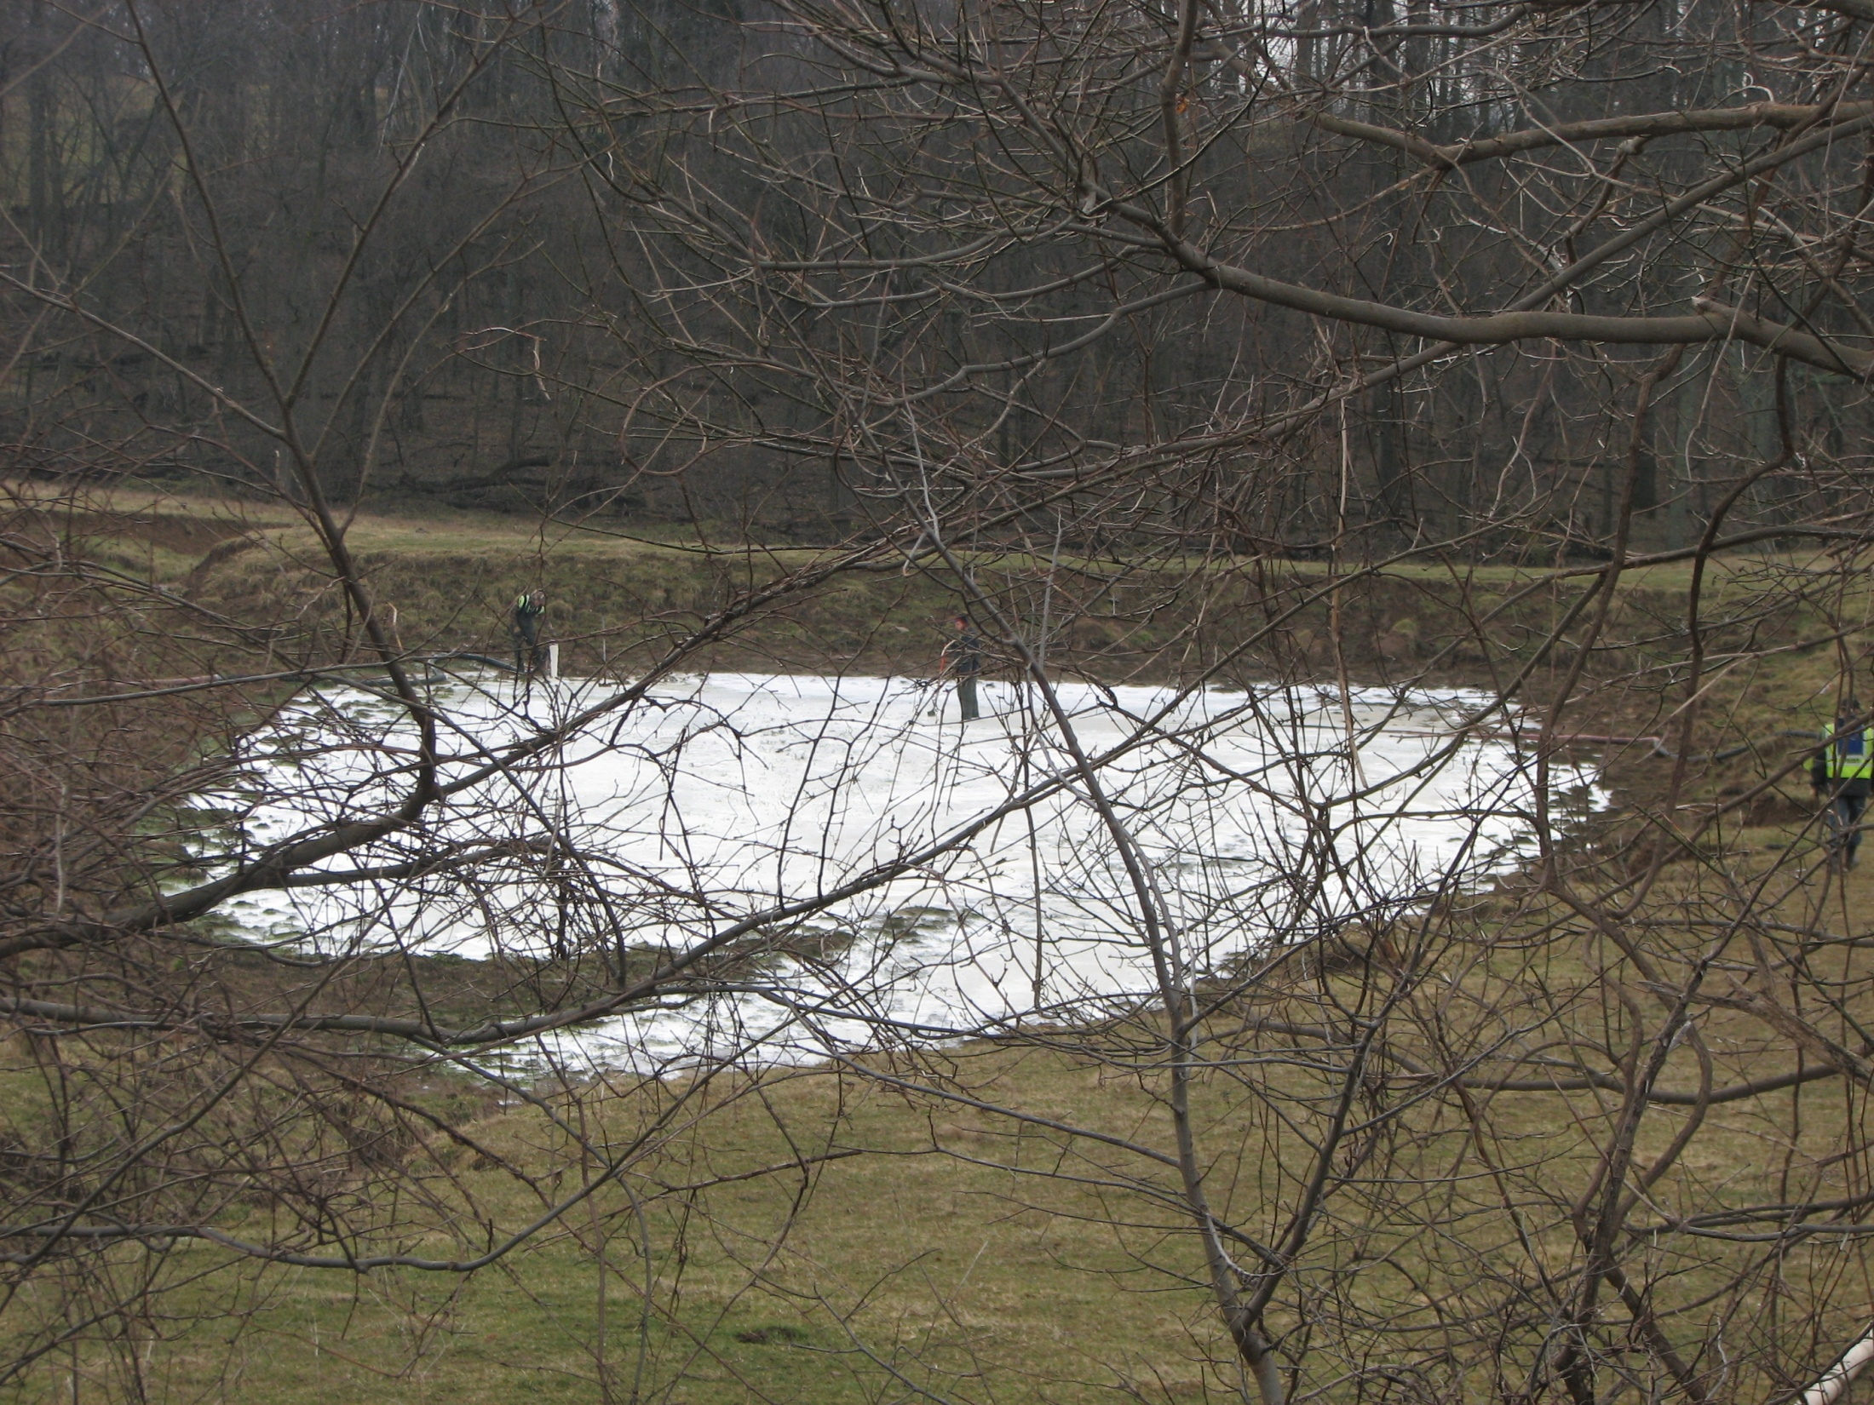

Slide 26
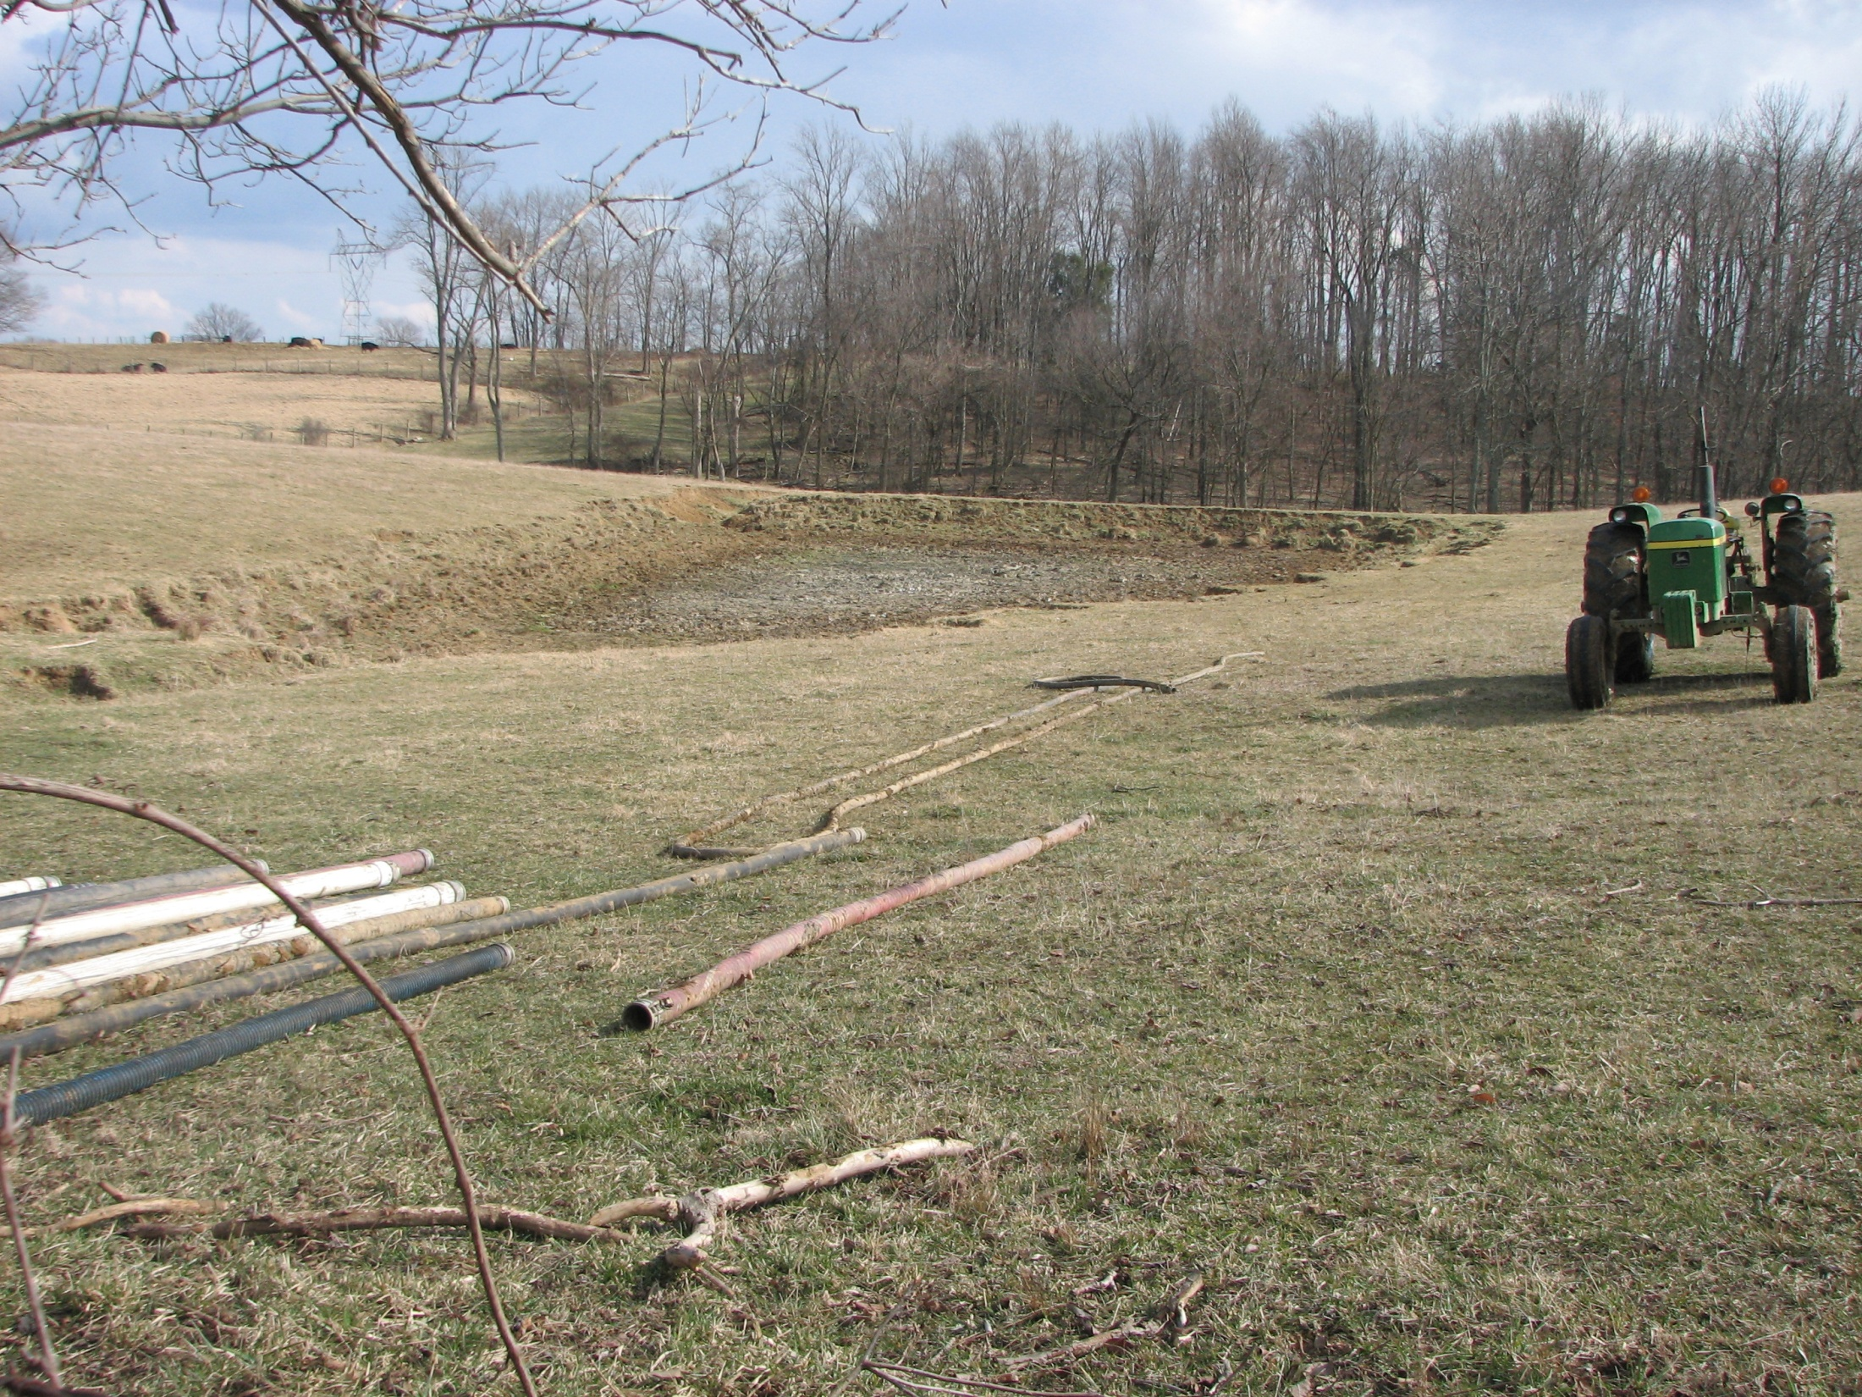

Slide 27
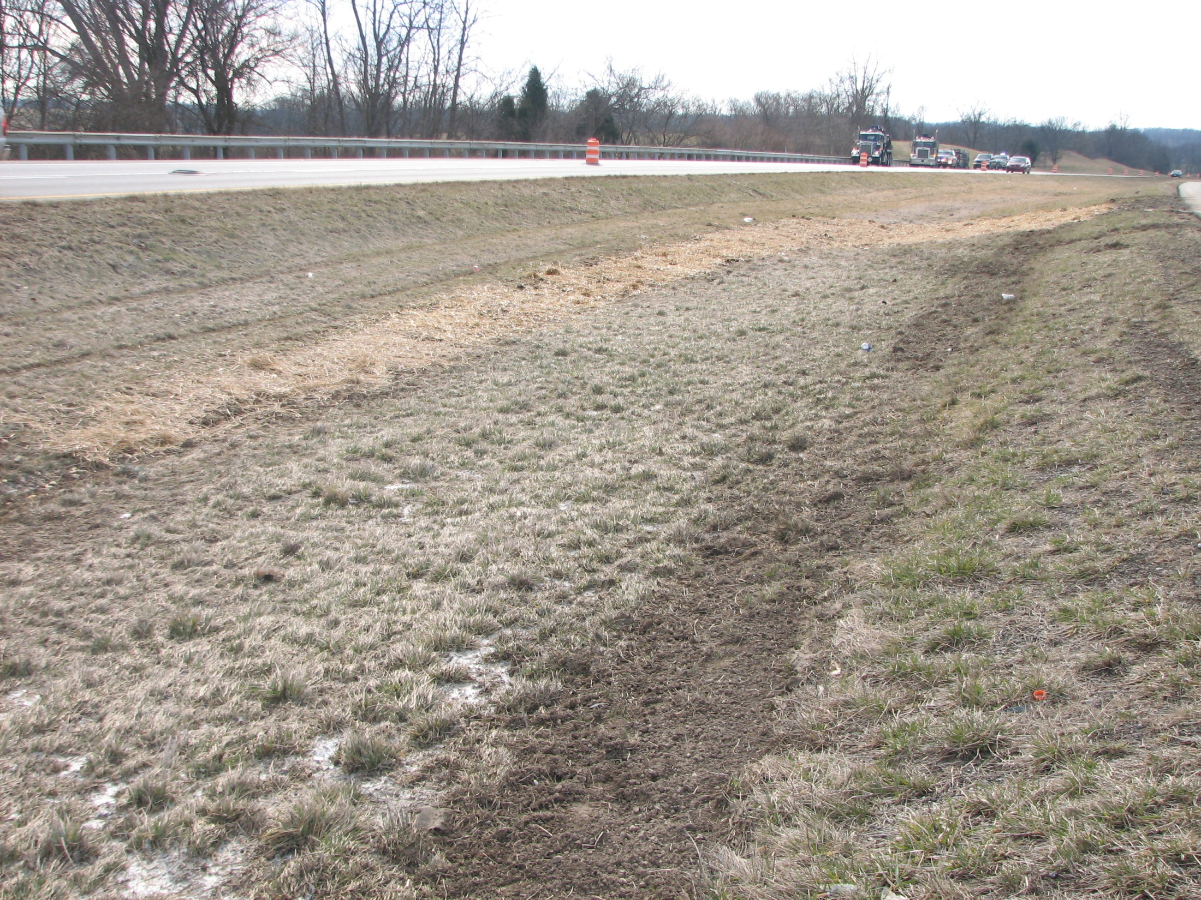

Slide 28
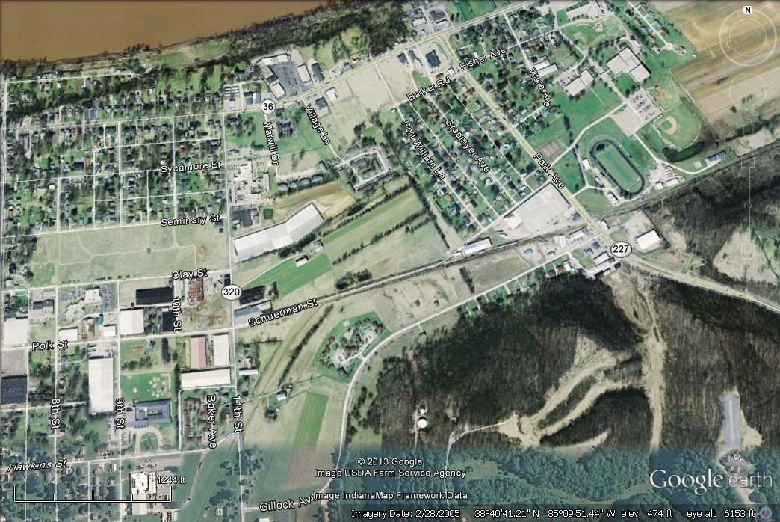

Slide 29
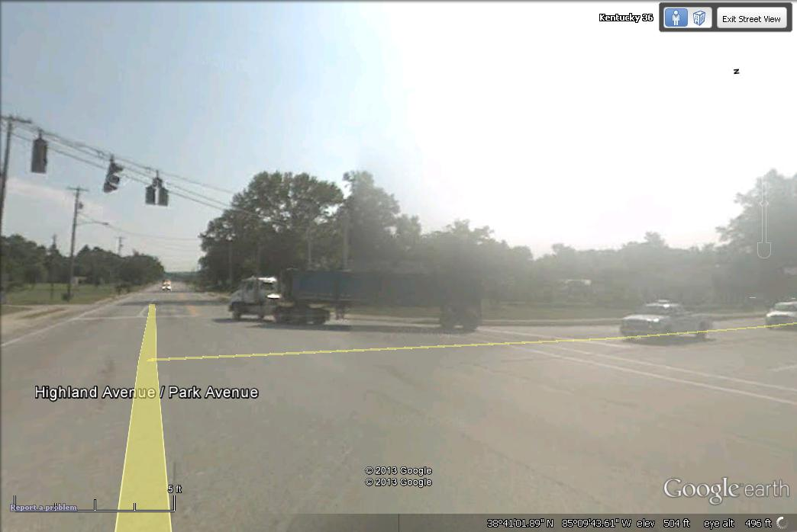

Slide 30
Incident Review
Manage to Survive Video for First Responders
IACP TIM Video

Slide 31
Crash Statistics
Quarterly Crash Statistics
KSP CRASH Database
Valerie Januski
District 6 Safety Officer

Slide 32
Southeast Counties

Slide 38
Southwest Counties

Slide 44
Construction Update

Slide 45
Other Business
Information Sharing

Slide 46
Adjourn
Next Meeting
Tuesday July 9, 2013
1:00 PM

